Slide 1

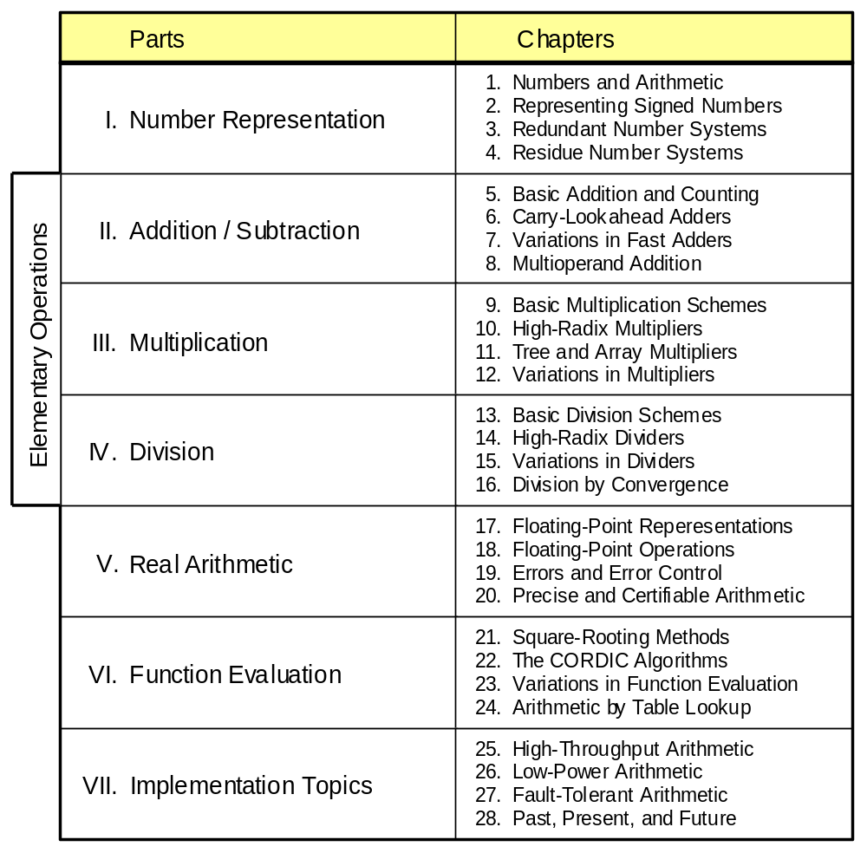
Part II
Addition / Subtraction

Slide 2
About This Presentation
This presentation is intended to support the use of the textbook Computer Arithmetic: Algorithms and Hardware Designs (Oxford University Press, 2000, ISBN 0-19-512583-5). It is updated regularly by the author as part of his teaching of the graduate course ECE 252B, Computer Arithmetic, at the University of California, Santa Barbara. Instructors can use these slides freely in classroom teaching and for other educational purposes. Unauthorized uses are strictly prohibited. © Behrooz Parhami
Edition | Released | Revised | Revised | Revised | Revised
First | Jan. 2000 | Sep. 2001 | Sep. 2003 | Oct. 2005 | Apr. 2007

Slide 3
II Addition / Subtraction
Review addition schemes and various speedup methods
  Addition is a key op (in itself, and as a building block)
  Subtraction = negation + addition
  Carry propagation speedup: lookahead, skip, select, …
  Two-operand versus multioperand addition
Topics in This Part
Chapter 5 Basic Addition and Counting
Chapter 6 Carry-Lookahead Adders
Chapter 7 Variations in Fast Adder
Chapter 8 Multioperand Addition

Slide 4

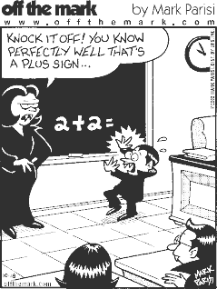

Slide 5
5 Basic Addition and Counting
Chapter Goals
Study the design of ripple-carry adders,
discuss why their latency is unacceptable,
and set the foundation for faster adders
Chapter Highlights
Full adders are versatile building blocks
Longest carry chain on average: log₂k bits
Fast asynchronous adders are simple
Counting is relatively easy to speed up

Slide 6
Basic Addition and Counting: Topics
Topics in This Chapter
5.1. Bit-Serial and Ripple-Carry Adders
5.2. Conditions and Exceptions
5.3. Analysis of Carry Propagation
5.4. Carry Completion Detection
5.5. Addition of a Constant
5.6. Manchester Carry Chains and Adders

Slide 7
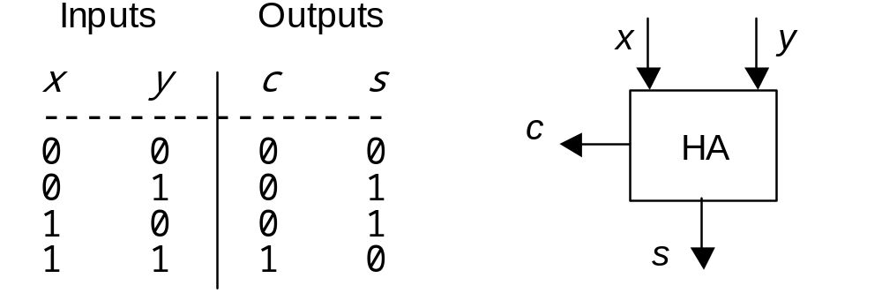
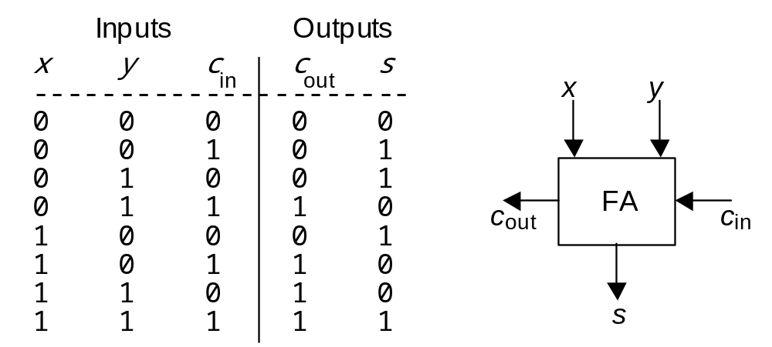
5.1 Bit-Serial and Ripple-Carry Adders
Half-adder (HA): Truth table and block diagram
Full-adder (FA): Truth table and block diagram

Slide 8
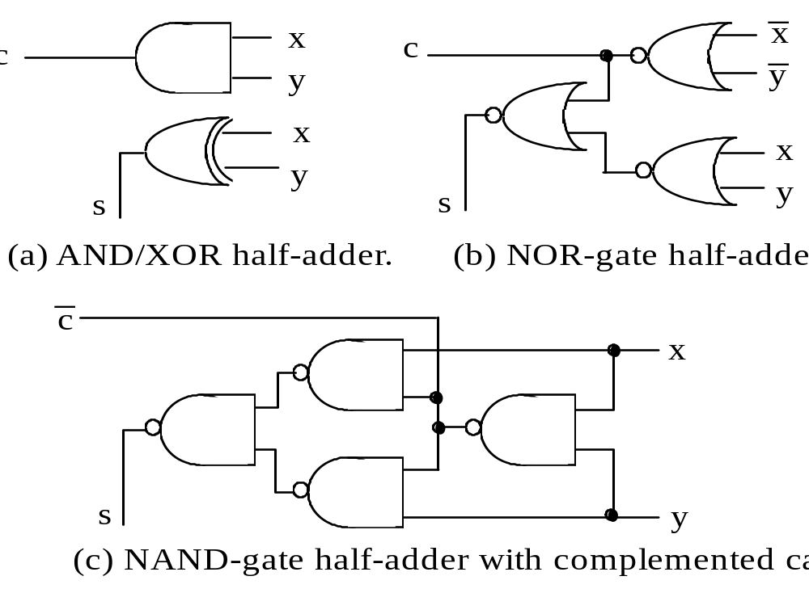
Half-Adder Implementations
c
Fig. 5.1 Three implementations of a half-adder.

Slide 9
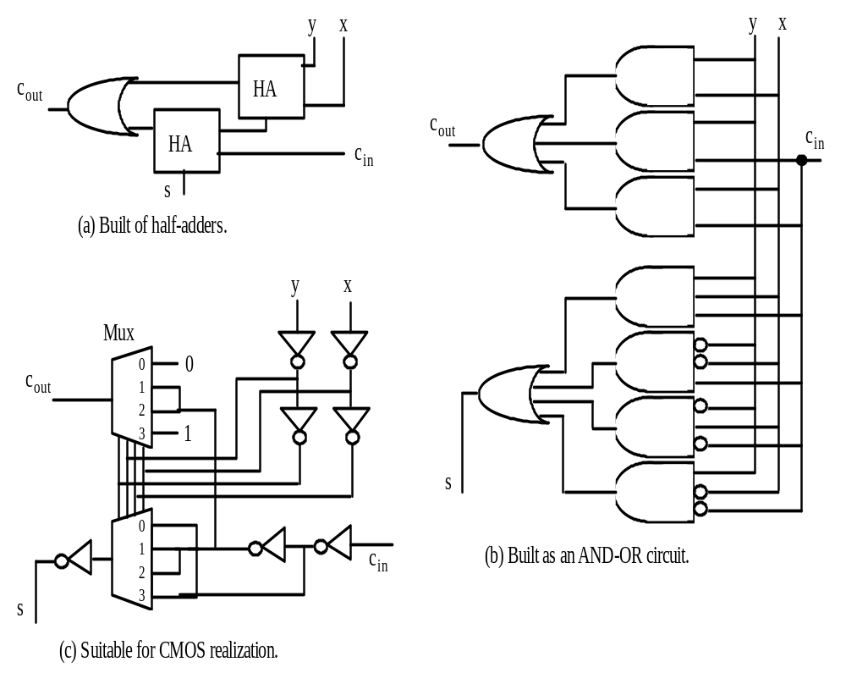
Full-Adder Implementations
Fig. 5.2 Possible designs for a full-adder in terms of half-adders, logic gates, and CMOS transmission gates.

Slide 10
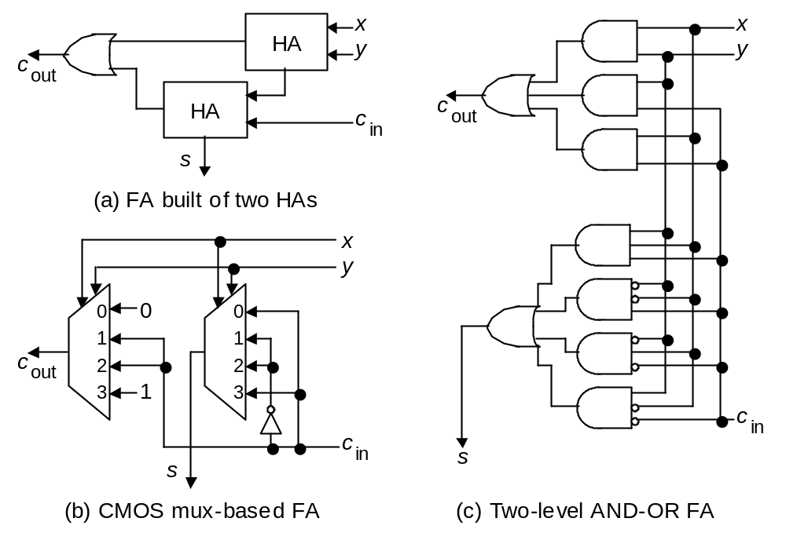
Full-Adder Implementations
Fig. 5.2 (alternate version) Possible designs for a full-adder in terms of half-adders, logic gates, and CMOS transmission gates.

Slide 11
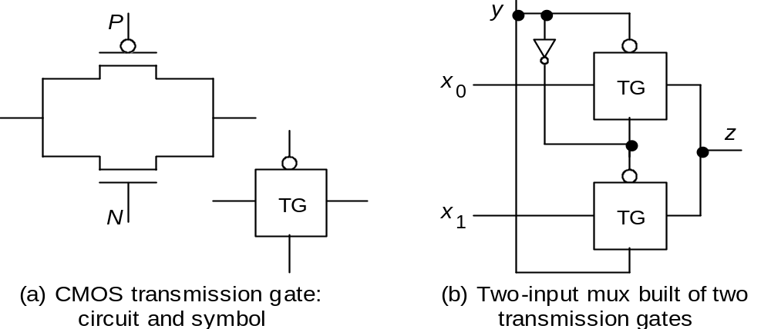
Some Full-Adder Details
Logic equations for a full-adder:
s = x ⊕ y ⊕ c_{in} (odd parity function)
= x y c_{in} ∨ x ′ y ′ c_{in} ∨ x ′ y c_{in}′ ∨ x y ′ c_{in}′
c_{out} = x y ∨ x c_{in} ∨ y c_{in} (majority function)
CMOS transmission gate and its use in a 2-to-1 mux.

Slide 12
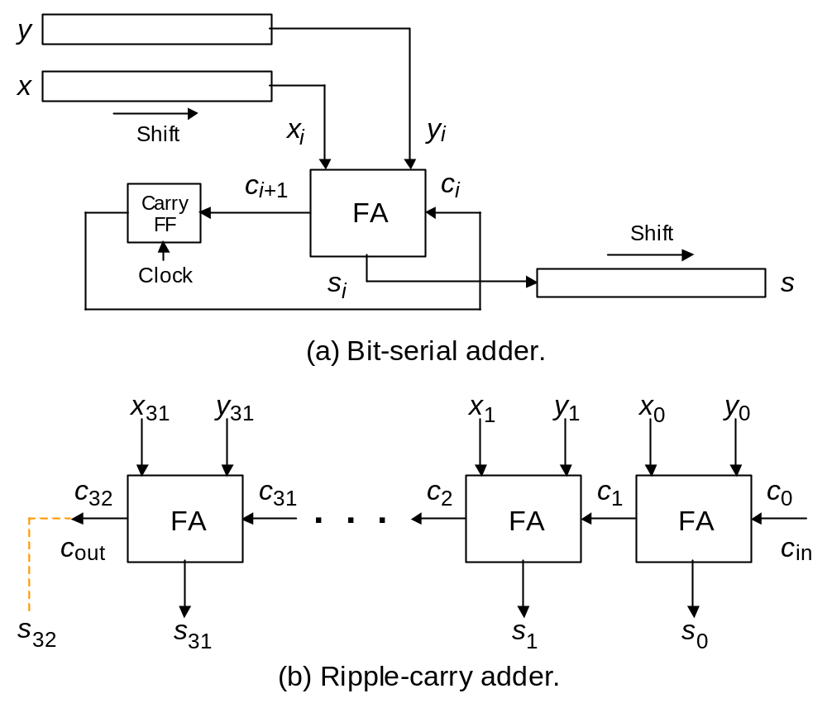
Simple Adders Built of Full-Adders
Fig. 5.3 Using full-adders in building bit-serial and ripple-carry adders.

Slide 13
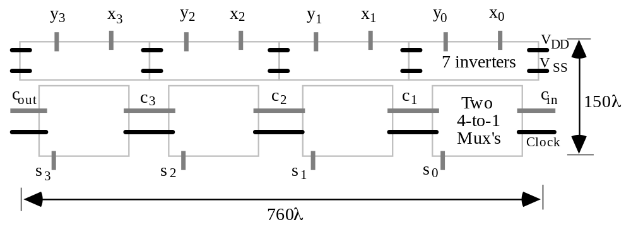
VLSI Layout of a Ripple-Carry Adder
Fig. 5.4 The layout of a 4-bit ripple-carry adder in CMOS implementation [Puck94].

Slide 14
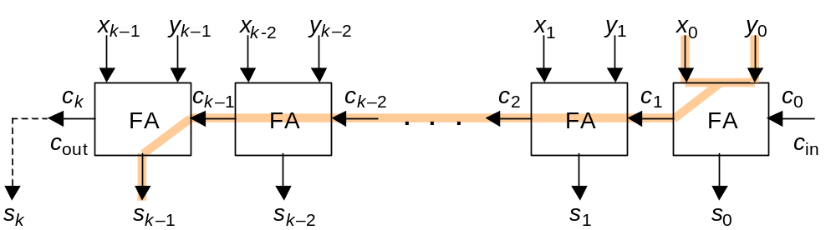
Critical Path Through a Ripple-Carry Adder
T_{ripple-add} = T_{FA}(x,y→c_{out}) + (k – 2)×T_{FA}(c_{in}→cout) + T_{FA}(c_{in}→s)
Fig. 5.5 Critical path in a k-bit ripple-carry adder.

Slide 15
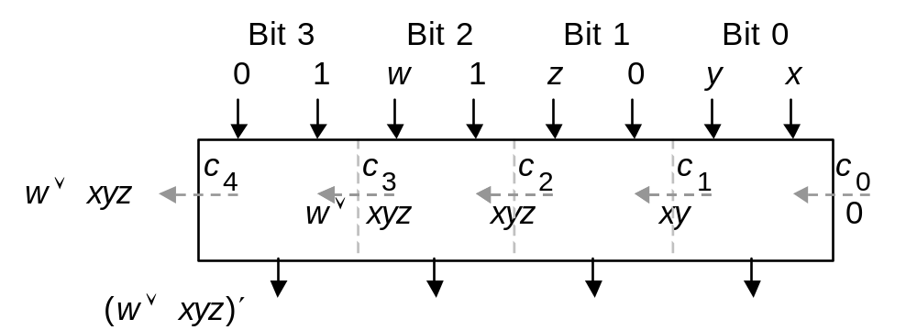
Binary Adders as Versatile Building Blocks
Set one input to 0: c_{out} = AND of other inputs
Set one input to 1: c_{out} = OR of other inputs
Set one input to 0
and another to 1: s = NOT of third input
Fig. 5.6 Four-bit binary adder used to realize the logic function f = w + xyz and its complement.

Slide 16
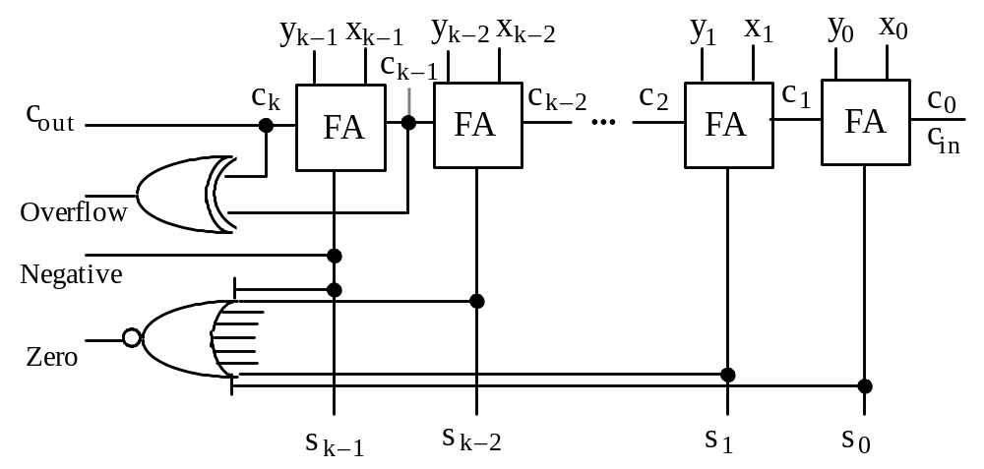
5.2 Conditions and Exceptions
Fig. 5.7 Two’s-complement adder with provisions for detecting conditions and exceptions.
overflow_{2’s-compl} = x_{k–1} y_{k–1} s_{k–1}′ ∨ x_{k–1}′ y_{k–1}′ s_{k–1}
overflow_{2’s-compl} = c_{k} ⊕ c_{k–1} = c_{k} c_{k–1}′ ∨ c_{k}′ c_{k–1}

Slide 17
Saturating Adders
Saturating (saturation) arithmetic:
When a result’s magnitude is too large, do not wrap around; rather, provide the most positive or the most negative value that is representable in the number format
Example – In 8-bit 2’s-complement format, we have:
120 + 26 → 18 (wraparound); 120 +_{sat} 26 → 127 (saturating)
Saturating arithmetic in desirable in many DSP applications
Designing saturating adders
Adder
0
1
Unsigned (quite easy)
Signed (only slightly harder)
Overflow
Saturation value

Slide 18
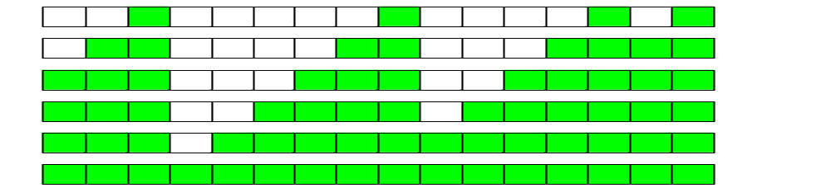
5.3 Analysis of Carry Propagation
Bit positions
15 14 13 12 11 10 9 8 7 6 5 4 3 2 1 0
----------- ----------- ----------- -----------
1 0 1 1 0 1 1 0 0 1 1 0 1 1 1 0
c_{out} 0 1 0 1 1 0 0 1 1 1 0 0 0 0 1 1 c_{in}
\__________/\__________________/ \________/\____/
4 6 3 2
Carry chains and their lengths
Fig. 5.8 Example addition and its carry propagation chains.

Slide 19
Using Probability to Analyze Carry Propagation
Given binary numbers with random bits, for each position i we have
Probability of carry generation = ¼ (both 1s)
Probability of carry annihilation = ¼ (both 0s)
Probability of carry propagation = ½ (different)
Probability that carry generated at position i propagates through position j – 1 and stops at position j (j > i)
2^{–(j–1–i)} × 1/2 = 2^{–(j–i)}
Expected length of the carry chain that starts at position i
2 – 2^{–(k–i–1)}
Average length of the longest carry chain in k-bit addition is strictly less than log₂k; it is log₂(1.25k) per experimental results
Analogy: Expected number when rolling one die is 3.5; if one rolls many dice, the expected value of the largest number shown grows

Slide 20
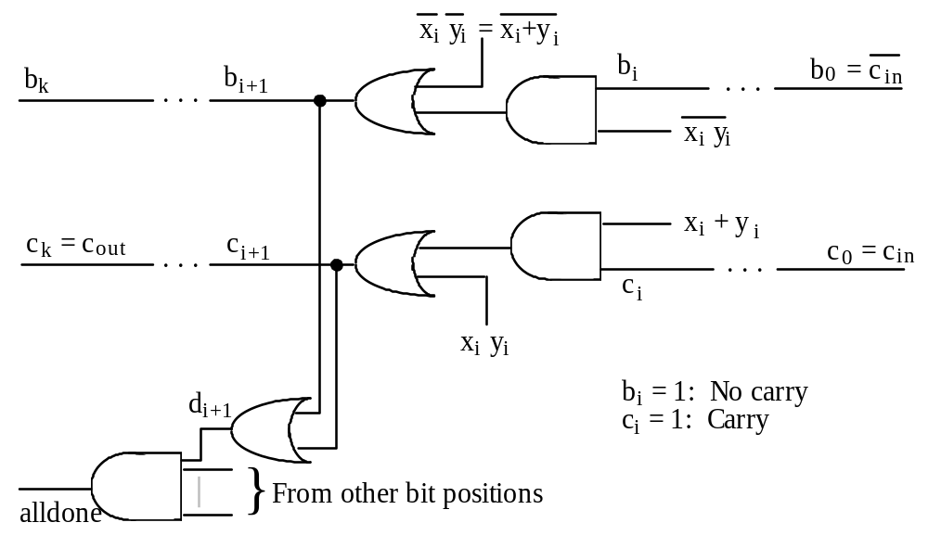
5.4 Carry Completion Detection
b_{i} c_{i}
0 0 Carry not yet known
0 1 Carry known to be 1
1 0 Carry known to be 0
Fig. 5.9 Example addition and its carry propagation chains.

Slide 21
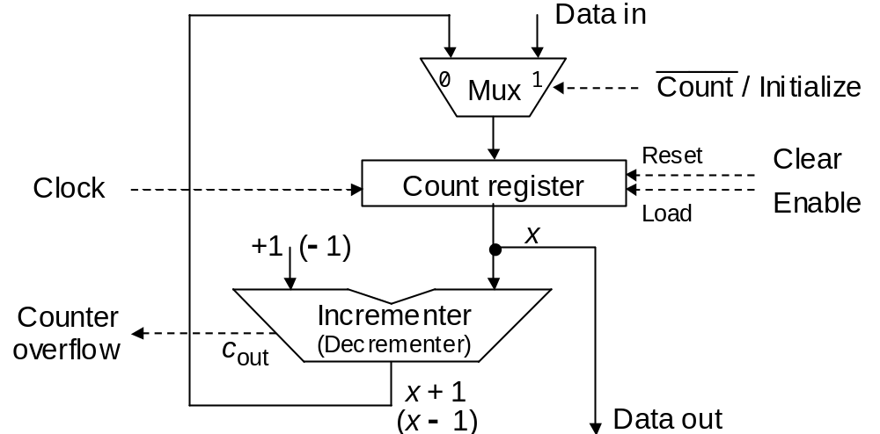
5.5 Addition of a Constant: Counters
Fig. 5.10 An up (down) counter built of a register, an incrementer (decrementer), and a multiplexer.

Slide 22
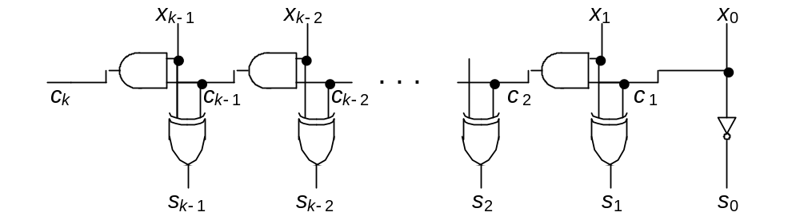
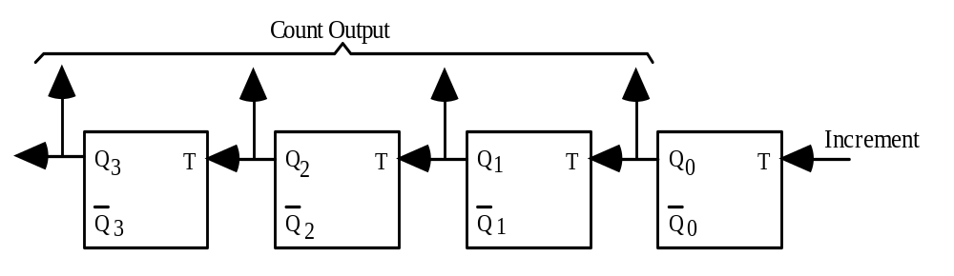
Implementing a Simple Up Counter
(Fm arch text) Ripple-carry incrementer for use in an up counter.
Fig. 5.11 Four-bit asynchronous up counter built only of negative-edge-triggered T flip-flops.

Slide 23
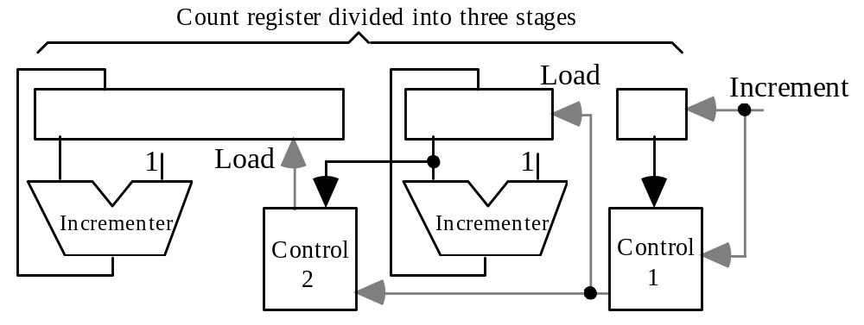
Faster and Constant-Time Counters
Any fast adder design can be specialized and optimized to yield a fast counter (carry-lookahead, carry-skip, etc.)
One can use redundant representation to build a constant-time counter, but a conversion penalty must be paid during read-out
Fig. 5.12 Fast (constant-time) three-stage up counter.

Slide 24
1.6 Manchester Carry Chains and Adders
Sum digit in radix r s_{i} = (x_{i} + y_{i} + c_{i}) mod r
Special case of radix 2 s_{i} = x_{i} ⊕ y_{i} ⊕ c_{i}
Computing the carries c_{i} is thus our central problem
For this, the actual operand digits are not important
What matters is whether in a given position a carry is
generated, propagated, or annihilated (absorbed)
For binary addition:
g_{i} = x_{i} y_{i} p_{i} = x_{i} ⊕ y_{i} a_{i} = x_{i}′y_{i} ′ = (x_{i} ∨ y_{i}) ′
It is also helpful to define a transfer signal:
t_{i} = g_{i} ∨ p_{i} = a_{i}′ = x_{i} ∨ y_{i}
Using these signals, the carry recurrence is written as
c_{i+1} = g_{i} ∨ c_{i} p_{i} = g_{i} ∨ c_{i} g_{i} ∨ c_{i} p_{i} = g_{i} ∨ c_{i} t_{i}

Slide 25
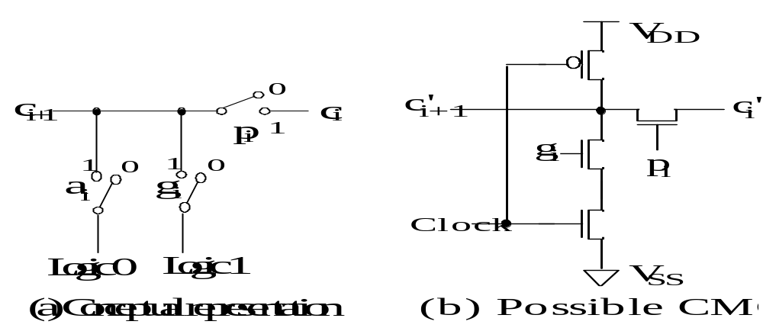
Manchester Carry Network
The worst-case delay of a Manchester carry chain has three components:
1. Latency of forming the switch control signals
2. Set-up time for switches
3. Signal propagation delay through k switches
Fig. 5.13 One stage in a Manchester carry chain.

Slide 26
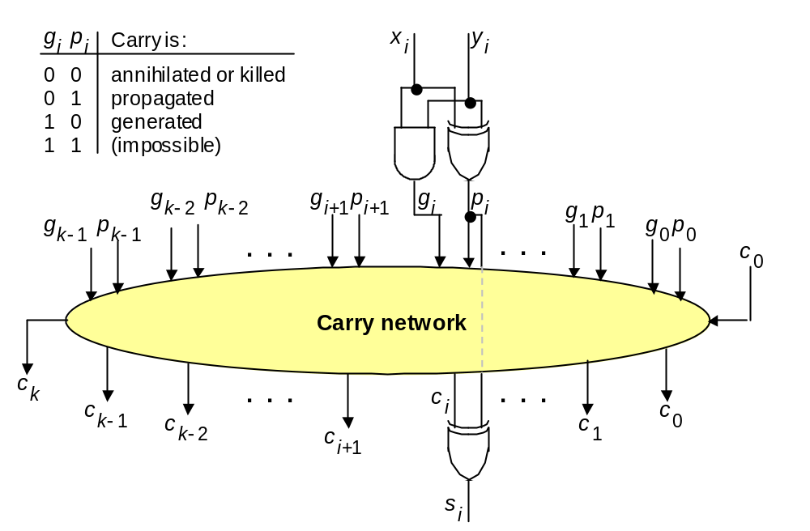
Carry Network is the Essence of a Fast Adder
g_{i} = x_{i} y_{i}
p_{i} = x_{i} ⊕ y_{i}
Ripple; Skip;
Lookahead;
Parallel-prefix
(Fm arch text) The main part of an adder is the carry network. The rest is just a set of gates to produce the g and p signals and the sum bits.

Slide 27
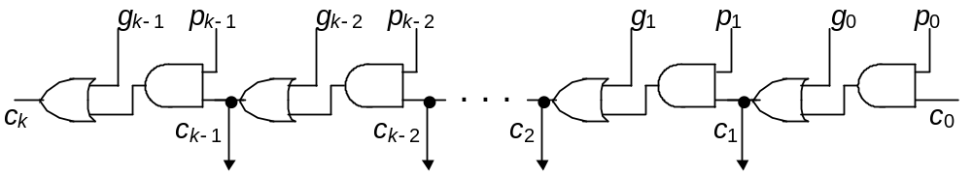
Ripple-Carry Adder Revisited
The carry recurrence: c_{i+1} = g_{i} ∨ p_{i} c_{i}
Latency of k-bit adder is roughly 2k gate delays:
1 gate delay for production of p and g signals, plus
2(k – 1) gate delays for carry propagation, plus
1 XOR gate delay for generation of the sum bits
Fig. 10.6 (arch book) The carry propagation network of a ripple-carry adder.

Slide 28
The Complete Design of a Ripple-Carry Adder
g_{i} = x_{i} y_{i}
p_{i} = x_{i} ⊕ y_{i}
Figure 10.6 (ripple-carry network) superimposed on Figure 10.5 (general structure of an adder).

Slide 29
6 Carry-Lookahead Adders
Chapter Goals
Understand the carry-lookahead method
and its many variations
used in the design of fast adders
Chapter Highlights
Single- and multilevel carry lookahead
Various designs for log-time adders
Relating the carry determination problem
to parallel prefix computation
Implementing fast adders in VLSI

Slide 30
Carry-Lookahead Adders: Topics
Topics in This Chapter
6.1. Unrolling the Carry Recurrence
6.2. Carry-Lookahead Adder Design
6.3. Ling Adder and Related Designs
6.4. Carry Determination as Prefix Computation
6.5. Alternative Parallel Prefix Networks
6.6. VLSI Implementation Aspects

Slide 31
6.1 Unrolling the Carry Recurrence
Recall the generate, propagate, annihilate (absorb), and transfer signals:
Signal Radix r Binary
g_{i} is 1 iff x_{i} + y_{i} ≥ r x_{i} y_{i}
p_{i} is 1 iff x_{i} + y_{i} = r – 1 x_{i} ⊕ y_{i}
a_{i} is 1 iff x_{i} + y_{i} < r – 1 x_{i}′y_{i} ′ = (x_{i} ∨ y_{i}) ′
t_{i} is 1 iff x_{i} + y_{i} ≥ r – 1 x_{i} ∨ y_{i}
s_{i} (x_{i} + y_{i} + c_{i}) mod r x_{i} ⊕ y_{i} ⊕ c_{i}
The carry recurrence can be unrolled to obtain each carry signal directly from inputs, rather than through propagation
c_{i} = g_{i–1} ∨ c_{i–1} p_{i–1}
= g_{i–1} ∨ (g_{i–2} ∨ c_{i–2} p_{i–2}) p_{i–1}
= g_{i–1} ∨ g_{i–2} p_{i–1} ∨ c_{i–2} p_{i–2} p_{i–1}
= g_{i–1} ∨ g_{i–2} p_{i–1} ∨ g_{i–3} p_{i–2} p_{i–1} ∨ c_{i–3} p_{i–3} p_{i–2} p_{i–1}
= g_{i–1} ∨ g_{i–2} p_{i–1} ∨ g_{i–3} p_{i–2} p_{i–1} ∨ g_{i–4} p_{i–3} p_{i–2} p_{i–1} ∨ c_{i–4} p_{i–4} p_{i–3} p_{i–2} p_{i–1}
= . . .
Note:
Addition symbol vs logical OR

Slide 32
Full Carry Lookahead
x₃
y₃
x₂
y₂
x₁
y₁
x₀
y₀
c_{in}
. . .
s₃
s₂
s₁
s₀
Theoretically, it is possible to derive each sum digit directly from the inputs that affect it
Carry-lookahead adder design is simply a way of reducing the complexity of this ideal, but impractical, arrangement by hardware sharing among the various lookahead circuits

Slide 33
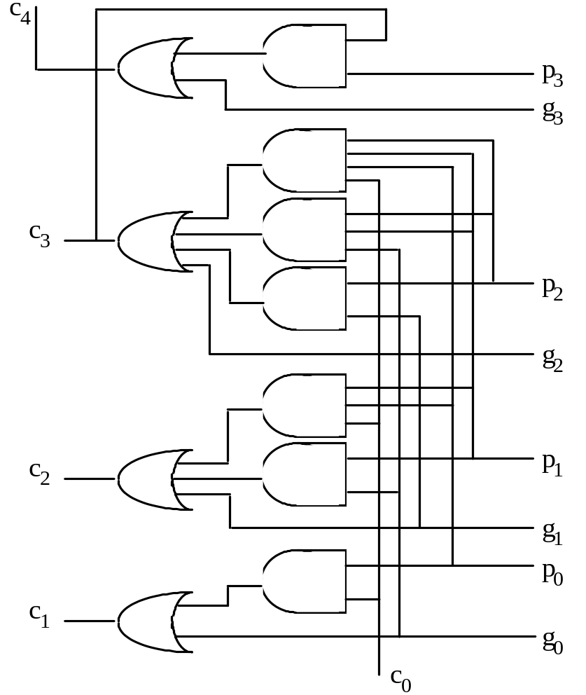
Four-Bit Carry-Lookahead Adder
Complexity reduced by deriving the carry-out indirectly
Full carry lookahead is quite practical for a 4-bit adder
c₁ = g₀ ∨ c₀ p₀
c₂ = g₁ ∨ g₀ p₁ ∨ c₀ p₀ p₁
c₃ = g₂ ∨ g₁ p₂ ∨ g₀ p₁ p₂ ∨ c₀ p₀ p₁ p₂
c₄ = g₃ ∨ g₂ p₃ ∨ g₁ p₂ p₃ ∨ g₀ p₁ p₂ p₃
∨ c₀ p₀ p₁ p₂ p₃
Fig. 6.1 Four-bit carry network with full lookahead.

Slide 34
Carry Lookahead Beyond 4 Bits
Consider a 32-bit adder
c₁ = g₀ ∨ c₀ p₀
c₂ = g₁ ∨ g₀ p₁ ∨ c₀ p₀ p₁
c₃ = g₂ ∨ g₁ p₂ ∨ g₀ p₁ p₂ ∨ c₀ p₀ p₁ p₂
.
.
.
c₃₁ = g₃₀ ∨ g₂₉ p₃₀ ∨ g₂₈ p₂₉ p₃₀ ∨ g₂₇ p₂₈ p₂₉ p₃₀ ∨ . . . ∨ c₀ p₀ p₁ p₂ p₃ ... p₂₉ p₃₀
32-input AND
. . .
High fan-ins necessitate tree-structured circuits
32-input OR

Slide 35
Two Solutions to the Fan-in Problem
High-radix addition (i.e., radix 2^{h})
Increases the latency for generating g and p signals and sum digits,
but simplifies the carry network (optimal radix?)
Multilevel lookahead
Example: 16-bit addition
Radix-16 (four digits)
Two-level carry lookahead (four 4-bit blocks)
Either way, the carries c₄, c₈, and c₁₂ are determined first
c₁₆ c₁₅ c₁₄ c₁₃ c₁₂ c₁₁ c₁₀ c₉ c₈ c₇ c₆ c₅ c₄ c₃ c₂ c₁ c₀
c_{out} ? ? ? c_{in}

Slide 36
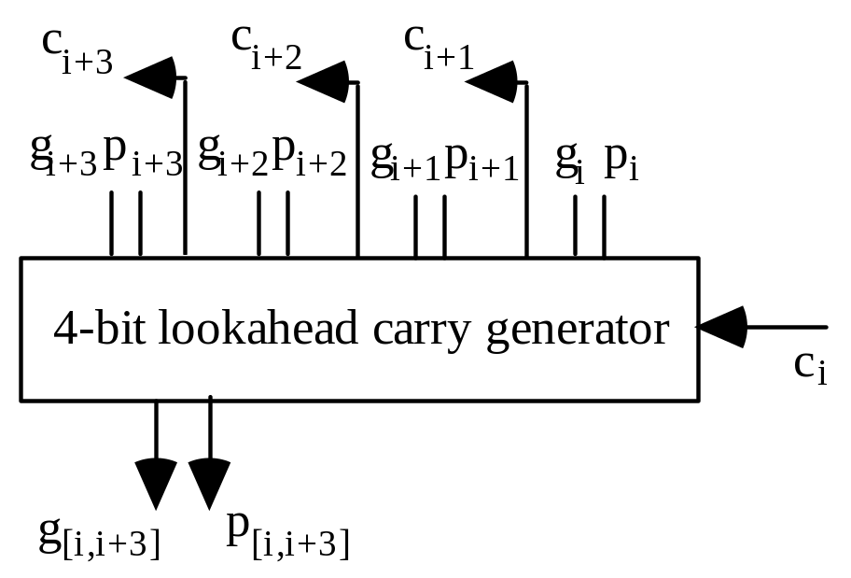
6.2 Carry-Lookahead Adder Design
Block generate and propagate signals
g _{[i,i+3]} = g_{i+3} ∨ g_{i+2} p_{i+3} ∨ g_{i+1} p_{i+2} p_{i+3} ∨ g_{i} p_{i+1} p_{i+2} p_{i+3}
p _{[i,i+3]} = p_{i} p_{i+1} p_{i+2} p_{i+3}
Fig. 6.3 Schematic diagram of a 4-bit lookahead carry generator.

Slide 37
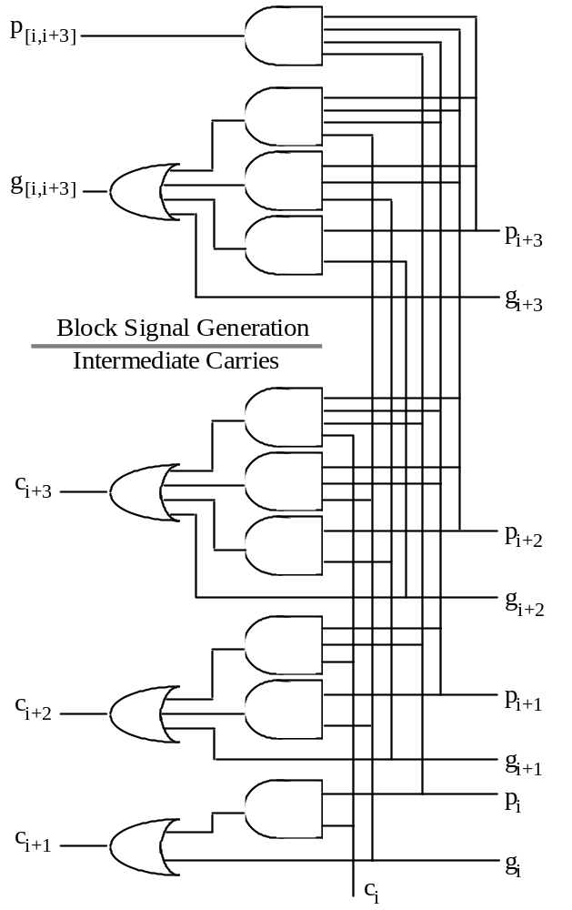
A Building Block for
Carry-Lookahead Addition
Fig. 6.2 Four-bit
lookahead
carry generator.
Fig. 6.1
Four-bit adder

Slide 38
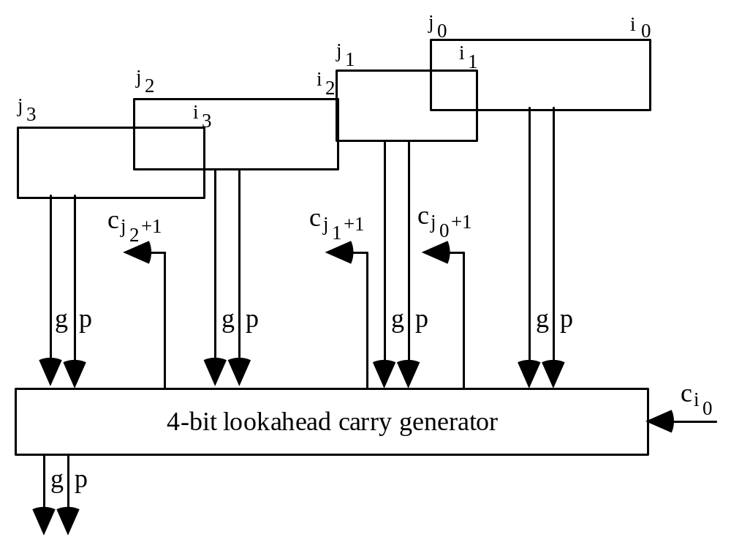
Combining Block g and p Signals
Block generate and propagate signals can be combined in the same way as bit g and p signals to form g and p signals for wider blocks
Fig. 6.4 Combining of g and p signals of four (contiguous or overlapping) blocks of arbitrary widths into the g and p signals for the overall block [i₀, j₃].

Slide 39
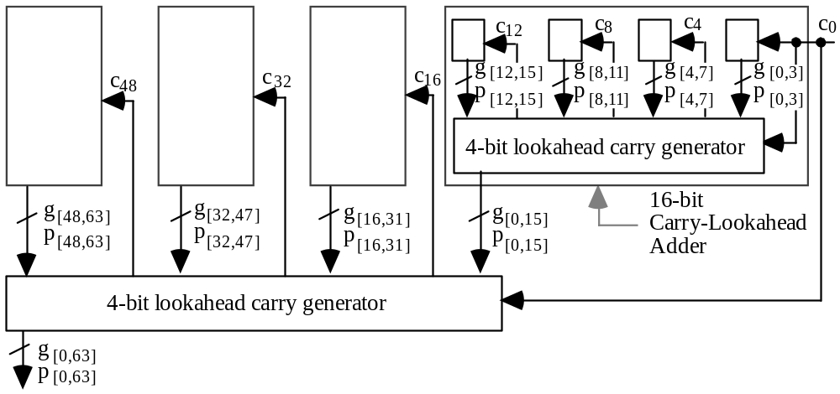
A Two-Level Carry-Lookahead Adder
Fig. 6.5 Building a 64-bit carry-lookahead adder from 16 4-bit adders and 5 lookahead carry generators.
Carry-out: c_{out} = g _{[0,k–1]} ∨ c₀ p _{[0,k–1]} = x_{k–1}y_{k–1} ∨ s_{k–1}′ (x_{k–1} ∨ y_{k–1})

Slide 40
Latency of a Multilevel Carry-Lookahead Adder
Latency through the 16-bit CLA adder consists of finding:
g and p for individual bit positions 1 gate level
g and p signals for 4-bit blocks 2 gate levels
Block carry-in signals c₄, c₈, and c₁₂ 2 gate levels
Internal carries within 4-bit blocks 2 gate levels
Sum bits 2 gate levels
Total latency for the 16-bit adder 9 gate levels
(compare to 32 gate levels for a 16-bit ripple-carry adder)
Each additional lookahead level adds 4 gate levels of latency
Latency for k-bit CLA adder: T_{lookahead-add} = 4 log₄k + 1 gate levels

Slide 41
6.3 Ling Adder and Related Designs
Consider the carry recurrence and its unrolling by 4 steps:
c_{i} = g_{i–1} ∨ c_{i–1} t_{i–1}
= g_{i–1} ∨ g_{i–2} t_{i–1} ∨ g_{i–3} t_{i–2} t_{i–1} ∨ g_{i–4} t_{i–3} t_{i–2} t_{i–1} ∨ c_{i–4} t_{i–4} t_{i–3} t_{i–2} t_{i–1}
Ling’s modification: Propagate h_{i} = c_{i} ∨ c_{i–1} instead of c_{i}
h_{i} = g_{i–1} ∨ h_{i–1} t_{i–2}
= g_{i–1} ∨ g_{i–2} ∨ g_{i–3} t_{i–2} ∨ g_{i–4} t_{i–3} t_{i–2} ∨ h_{i–4} t_{i–4} t_{i–3} t_{i–2}
CLA: 5 gates max 5 inputs 19 gate inputs
Ling: 4 gates max 5 inputs 14 gate inputs
The advantage of h_{i} over c_{i} is even greater with wired-OR:
CLA: 4 gates max 5 inputs 14 gate inputs
Ling: 3 gates max 4 inputs 9 gate inputs
Once h_{i} is known, however, the sum is obtained by a slightly more complex expression compared with s_{i} = p_{i} ⊕ c_{i}
s_{i} = (t_{i} ⊕ h_{i+1}) ∨ h_{i} g_{i} t_{i–1}

Slide 42
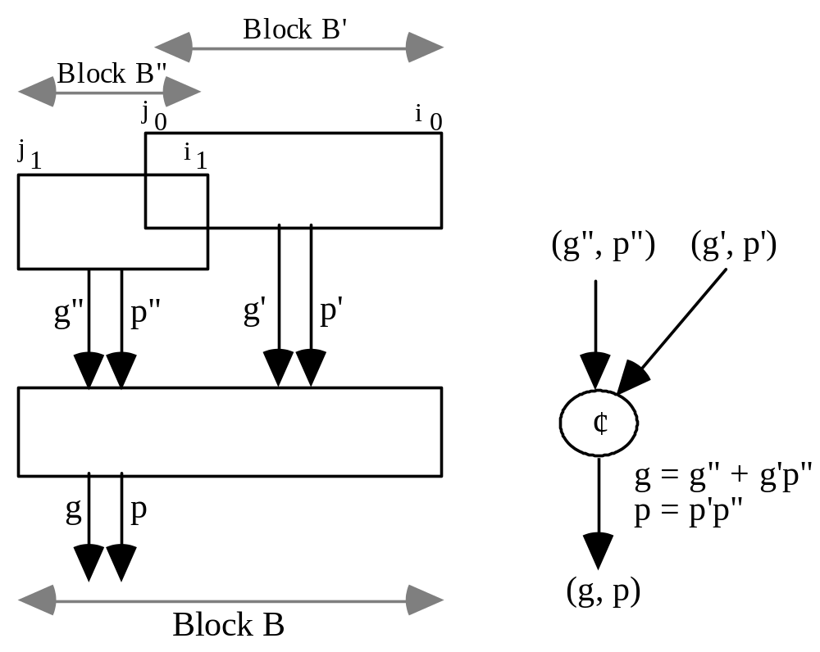
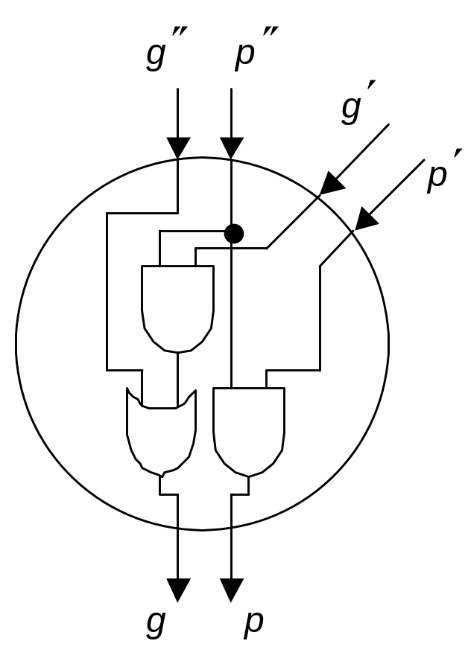
6.4 Carry Determination as Prefix Computation
Fig. 6.6 Combining of g and p signals of two (contiguous or overlapping) blocks B' and B" of arbitrary widths into the g and p signals for block B.

Slide 43
Formulating the Prefix Computation Problem
The problem of carry determination can be formulated as:
Given (g₀, p₀) (g₁, p₁) . . . (g_{k–2}, p_{k–2}) (g_{k–1}, p_{k–1})
Find (g _{[0,0]} , p _{[0,0]}) (g _{[0,1]} , p _{[0,1]}) . . . (g _{[0,k–2]} , p _{[0,k–2]}) (g _{[0,k–1]} , p _{[0,k–1]})
c₁ c₂ . . . c_{k–1} c_{k}
Carry-in can be viewed as an extra (−1) position: (g_{–1}, p_{–1}) = (c_{in}, 0)
The desired pairs are found by evaluating all prefixes of
(g₀, p₀) ¢ (g₁, p₁) ¢ . . . ¢ (g_{k–2}, p_{k–2}) ¢ (g_{k–1}, p_{k–1})
The carry operator ¢ is associative, but not commutative
[(g₁, p₁) ¢ (g₂, p₂)] ¢ (g₃, p₃) = (g₁, p₁) ¢ [(g₂, p₂) ¢ (g₃, p₃)]
Prefix sums analogy:
Given x₀ x₁ x₂ . . . x_{k–1}
Find x₀ x₀+x₁ x₀+x₁+x₂ . . . x₀+x₁+...+x_{k–1}

Slide 44
Example Prefix-Based Carry Network
g₃, p₃
g₂, p₂
g₁, p₁
g₀, p₀
6
−1
2
5
+
+
Four-input
prefix sums
network
+
+
12
6
7
5
g_{[0,3]}, p_{[0,3]}
= (c₄, --)
g_{[0,2]}, p_{[0,2]}
= (c₃, --)
g_{[0,1]}, p_{[0,1]}
= (c₂, --)
g_{[0,0]}, p_{[0,0]}
= (c₁, --)
Scan order
g₃, p₃
g₂, p₂
g₁, p₁
g₀, p₀
¢
¢
Four-bit
Carry lookahead network
¢
¢
g_{[0,3]}, p_{[0,3]}
= (c₄, --)
g_{[0,2]}, p_{[0,2]}
= (c₃, --)
g_{[0,1]}, p_{[0,1]}
= (c₂, --)
g_{[0,0]}, p_{[0,0]}
= (c₁, --)

Slide 45
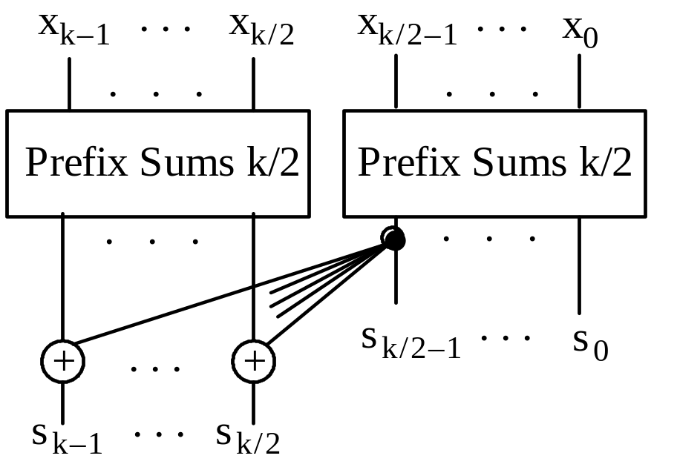
6.5 Alternative Parallel Prefix Networks
Fig. 6.7 Parallel prefix sums network built of two k/2-input networks and k/2 adders. (Ladner-Fischer)
Delay recurrence D(k) = D(k/2) + 1 = log₂k
Cost recurrence C(k) = 2C(k/2) + k/2 = (k/2) log₂k

Slide 46
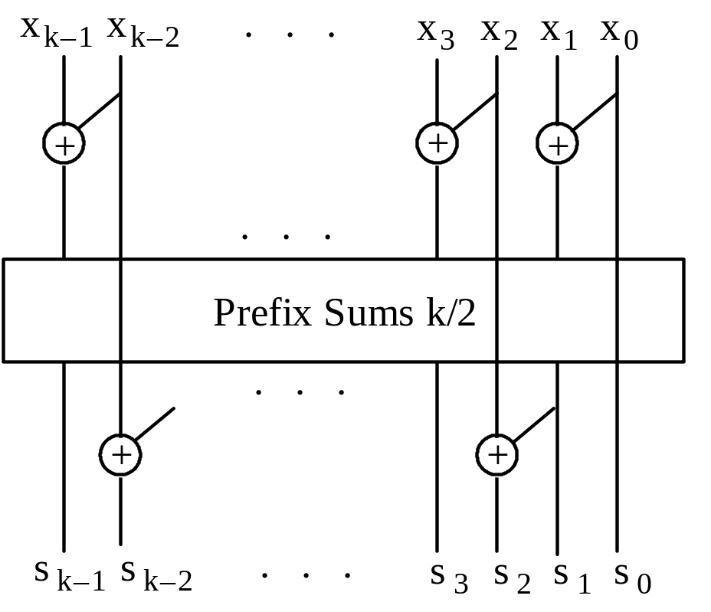
The Brent-Kung Recursive Construction
Fig. 6.8 Parallel prefix sums network built of one k/2-input network and k – 1 adders.
Delay recurrence D(k) = D(k/2) + 2 = 2 log₂k – 1 (–2 really)
Cost recurrence C(k) = C(k/2) + k – 1 = 2k – 2 – log₂k

Slide 47
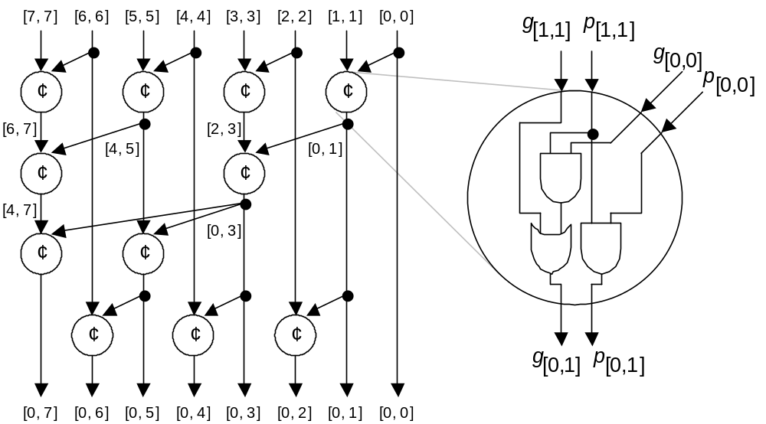
Brent-Kung Carry Network (8-Bit Adder)

Slide 48
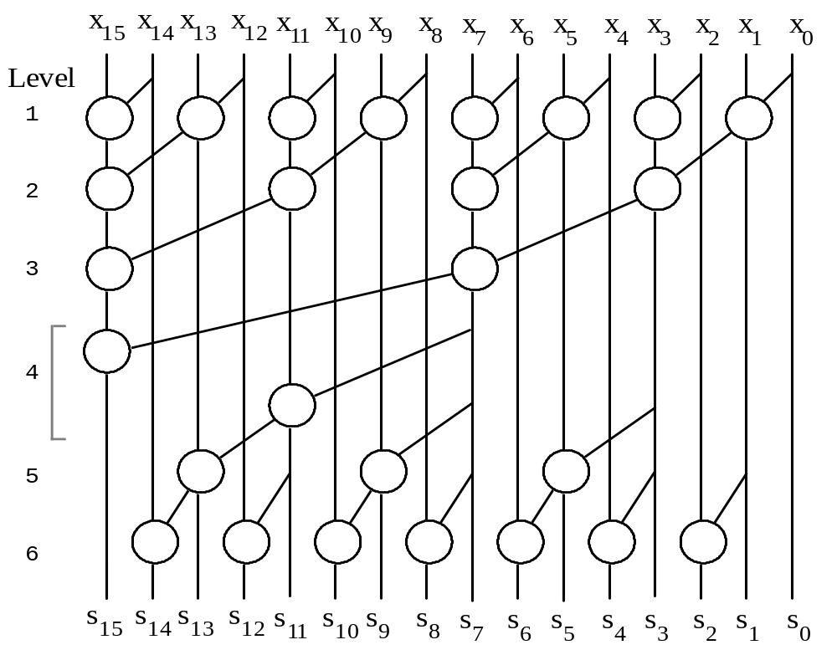
Brent-Kung Carry Network (16-Bit Adder)
Reason for latency being 2 log₂k – 2
Fig. 6.9 Brent-Kung parallel prefix graph for
16 inputs.

Slide 49
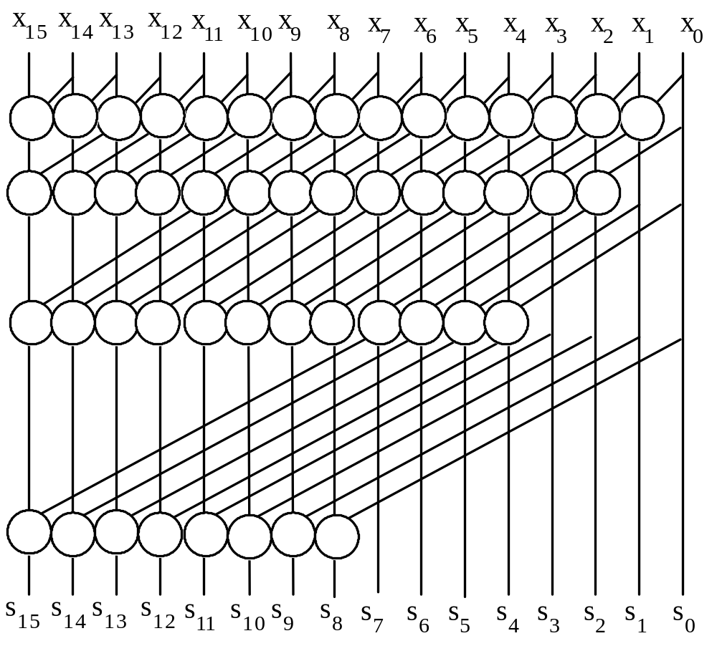
Kogge-Stone Carry Network (16-Bit Adder)
Cost formula
C(k) = (k – 1)
+ (k – 2)
+ (k – 4) + . . .
+ (k – k/2)
= k log₂k – k + 1
log₂k levels (minimum possible)
Fig. 6.10 Kogge-Stone parallel prefix graph for
16 inputs.

Slide 50
Speed-Cost Tradeoffs in Carry Networks
Method | Delay | Cost
Ladner-Fischer | log₂k | (k/2) log₂k
Kogge-Stone | log₂k | k log₂k – k + 1
Brent-Kung | 2 log₂k – 2 | 2k – 2 – log₂k
Improving the Ladner/Fischer design
These outputs can be produced one time unit later without increasing the overall latency
This strategy saves enough to make the overall cost linear (best possible)

Slide 51
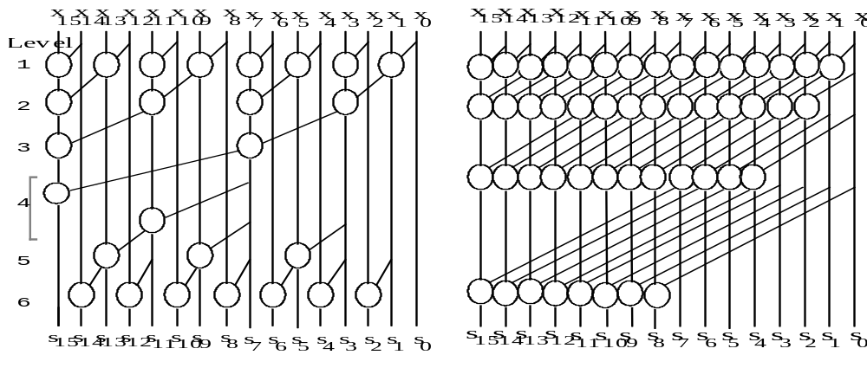
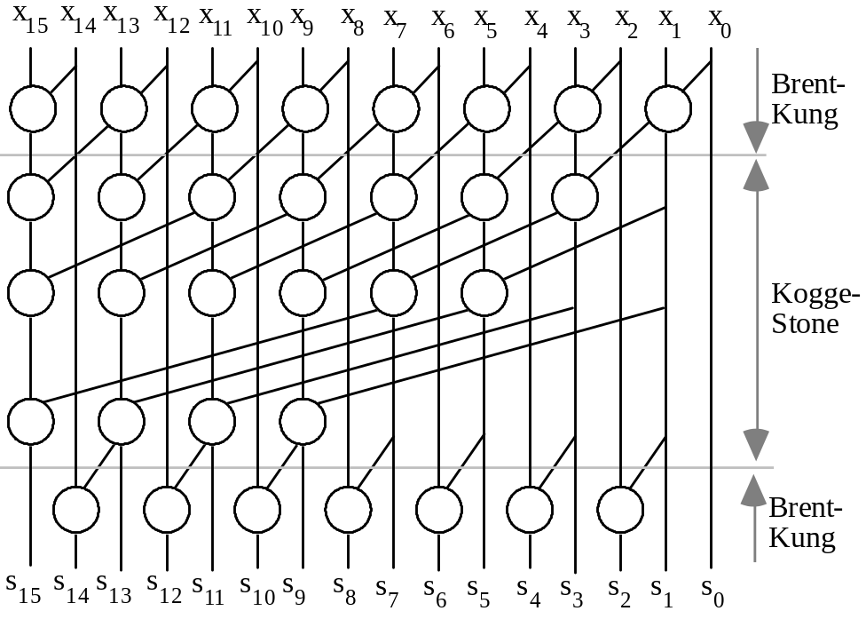
Hybrid B-K/K-S Carry Network (16-Bit Adder)
Brent-Kung:
6 levels
26 cells
Kogge-Stone:
4 levels
49 cells
Fig. 6.11
A Hybrid Brent-Kung/ Kogge-Stone parallel prefix graph for
16 inputs.
Hybrid:
5 levels
32 cells

Slide 52
6.6 VLSI Implementation Aspects
Example: Radix-256 addition of 56-bit numbers
as implemented in the AMD Am29050 CMOS micro
Our description is based on the 64-bit version of the adder
In radix-256, 64-bit addition, only these carries are needed:
c₅₆ c₄₈ c₄₀ c₃₂ c₂₄ c₁₆ c₈
First, 4-bit Manchester carry chains (MCCs) of Fig. 6.12a are used to derive g and p signals for 4-bit blocks
Next, the g and p signals for 4-bit blocks are combined to form the desired carries, using the MCCs in Fig. 6.12b

Slide 53
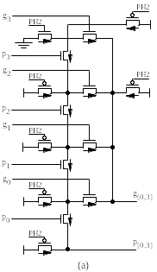
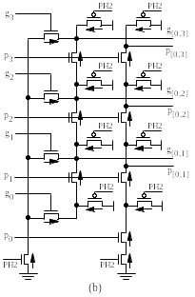
Four-Bit Manchester Carry Chains
Fig. 6.12 Example four-bit Manchester carry chain designs in CMOS technology [Lync92].

Slide 54
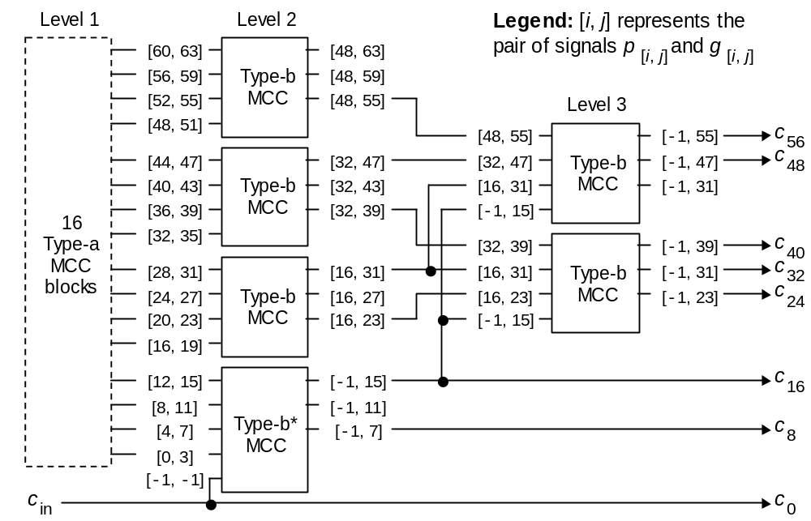
Carry Network for 64-Bit Adder
Fig. 6.13 Spanning-tree carry-lookahead network [Lync92]. The 16 MCCs at level 1, that produce generate and propagate signals for 4-bit blocks, are not shown.

Slide 55
7 Variations in Fast Adders
Chapter Goals
Study alternatives to the carry-lookahead
method for designing fast adders
Chapter Highlights
Many methods besides CLA are available
(both competing and complementary)
Best design is technology-dependent
(often hybrid rather than pure)
Knowledge of timing allows optimizations

Slide 56
Variations in Fast Adders: Topics
Topics in This Chapter
7.1. Simple Carry-Skip Adders
7.2. Multilevel Carry-Skip Adders
7.3. Carry-Select Adders
7.4. Conditional-Sum Adder
7.5. Hybrid Adder Designs
7.6. Optimizations in Fast Adders

Slide 57
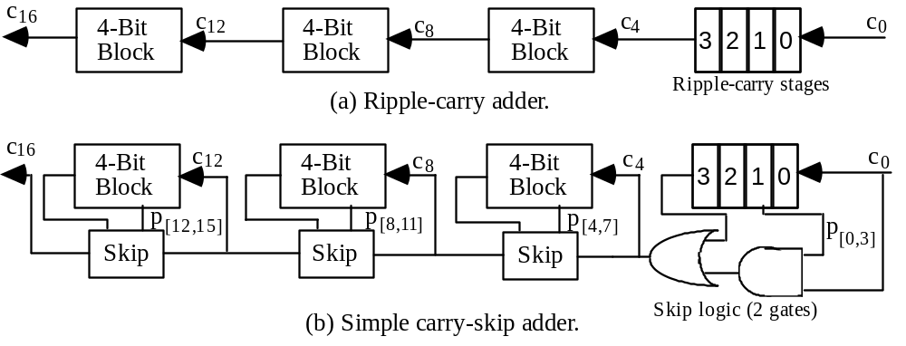
7.1 Simple Carry-Skip Adders
Fig. 7.1 Converting a 16-bit ripple-carry adder into a simple carry-skip adder with 4-bit skip blocks.

Slide 58
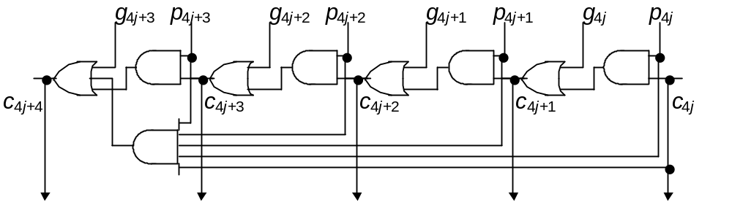
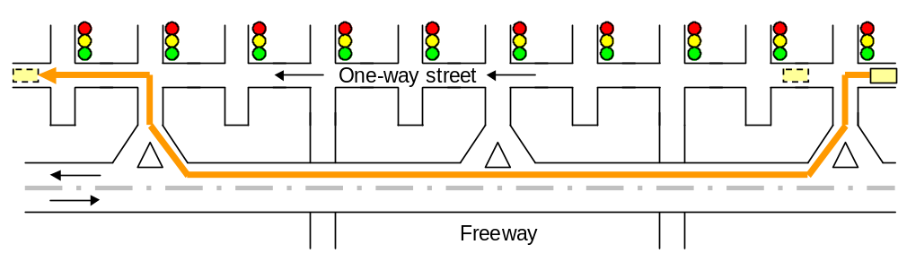
Another View of Carry-Skip Addition
Street/freeway analogy for carry-skip adder.

Slide 59
Carry-Skip Adder with Fixed Block Size
Block width b; k/b blocks to form a k-bit adder (assume b divides k)
T_{fixed-skip-add} = (b – 1) + 0.5 + (k/b – 2) + (b – 1)
in block 0 OR gate skips in last block
≅ 2b + k/b – 3.5 stages
dT/db = 2 – k/b² = 0 ⇒ b ^{opt} = √k/2
T ^{opt} = 2√2k – 3.5
. . .
Example: k = 32, b ^{opt} = 4, T ^{opt} = 12.5 stages
(contrast with 32 stages for a ripple-carry adder)

Slide 60
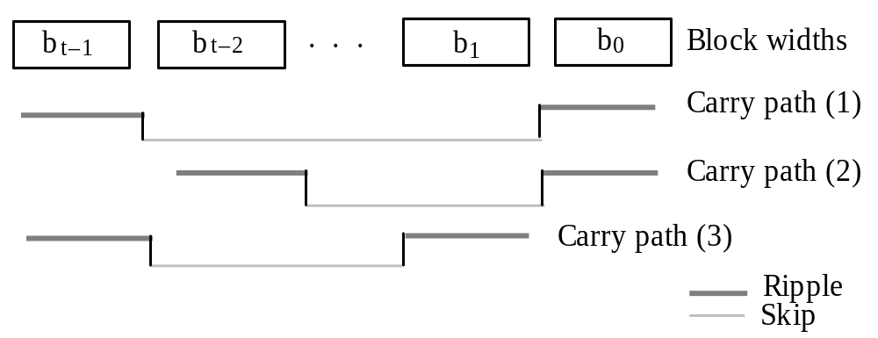
Carry-Skip Adder with Variable-Width Blocks
Fig. 7.2 Carry-skip adder with variable-size blocks and three sample carry paths.
The total number of bits in the t blocks is k:
2[b + (b + 1) + . . . + (b + t/2 – 1)] = t(b + t/4 – 1/2) = k
b = k/t – t/4 + 1/2
T_{var-skip-add} = 2(b – 1) + 0.5 + t – 2 = 2k/t + t/2 – 2.5
dT/db = –2k/t ² + 1/2 = 0 ⇒ t ^{opt} = 2√k
T ^{opt} = 2√k – 2.5 (a factor of √2 smaller than for fixed-block)

Slide 61
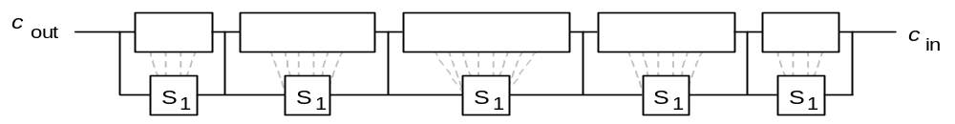
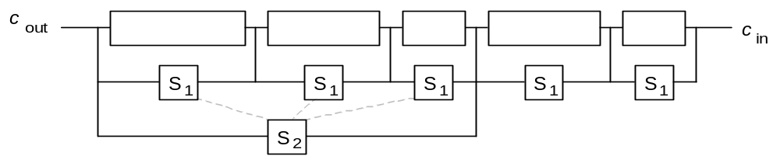
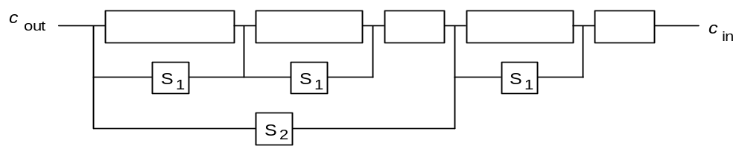
7.2 Multilevel Carry-Skip Adders
Fig. 7.3 Schematic diagram of a one-level carry-skip adder.
Fig. 7.4 Example of a two-level carry-skip adder.
Fig. 7.5 Two-level carry-skip adder optimized by removing the short-block skip circuits.

Slide 62
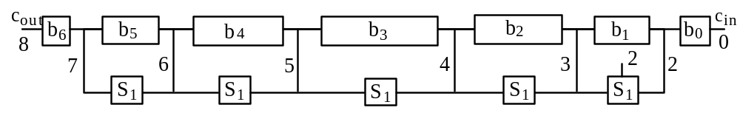
Designing a Single-Level Carry-Skip Adder
Example 7.1
Each of the following takes one unit of time: generation of g_{i} and p_{i}, generation of level-i skip signal from level-(i–1) skip signals, ripple, skip, and formation of sum bit once the incoming carry is known
Build the widest possible one-level carry-skip adder with total delay of 8
Fig. 7.6 Timing constraints of a single-level carry-skip adder with a delay of 8 units.
Max adder width = 18
(1 + 2 + 3 + 4 + 4 + 3 + 1)
Generalization of Example 7.1 for total time T (even or odd)
1 2 3 . . . T/2 T/2 . . . 4 3 1
1 2 3 . . . (T + 1)/2 . . . 4 3 1
Thus, for any T, the total width is ⎣(T + 1)²/4⎦ – 2

Slide 63
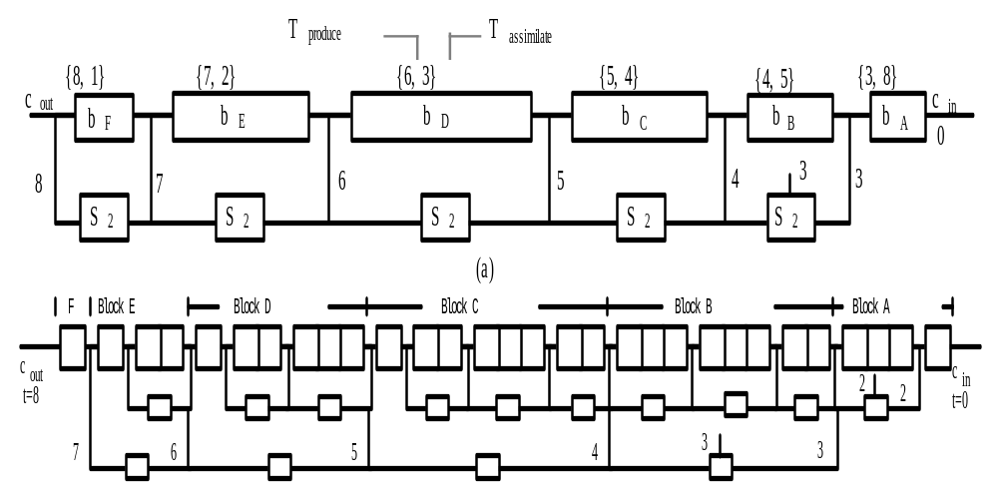
Designing a Two-Level Carry-Skip Adder
Example 7.2
Each of the following takes one unit of time: generation of g_{i} and p_{i}, generation of level-i skip signal from level-(i–1) skip signals, ripple, skip, and formation of sum bit once the incoming carry is known
Build the widest possible two-level carry-skip adder with total delay of 8
Max adder width = 30
(4 + 8 + 8 + 6 + 3 + 1)
Fig. 7.7 Two-level carry-skip adder with a delay of 8 units: (a) Initial timing constraints, (b) Final design.

Slide 64
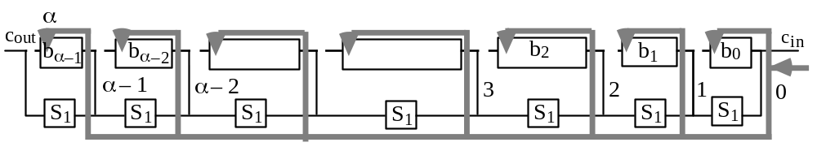
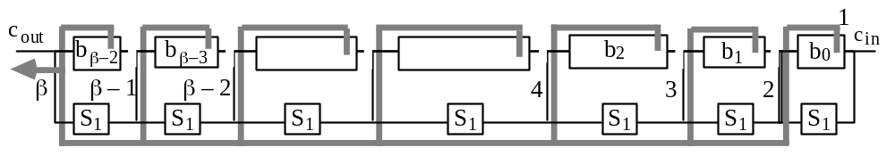
Elaboration on Two-Level Carry-Skip Adder
Example 7.2
Given the delay pair {β, α} for a level-2 block in Fig. 7.7a, the number of level-1 blocks that can be accommodated is γ = min(β – 1, α)
Single-level carry-skip adder with T_{assimilate} = α
Single-level carry-skip adder with T_{produce} = β
Width of the ith level-1 block in the level-2 block characterized by {β, α}
is b_{i} = min(β – γ + i + 1, α – i); the total block width is then ∑_{i=0 to γ–1} b_{i}

Slide 65

Carry-Skip Adder Optimization Scheme
Fig. 7.8 Generalized delay model for carry-skip adders.

Slide 66

7.3 Carry-Select Adders
Fig. 7.9 Carry-select adder for k-bit numbers built from three k/2-bit adders.
C_{select-add}(k) = 3C_{add}(k/2) + k/2 + 1
T_{select-add}(k) = T_{add}(k/2) + 1

Slide 67

Multilevel Carry-Select Adders
Fig. 7.10 Two-level carry-select adder built of k/4-bit adders.

Slide 68

7.4 Conditional-Sum Adder
Multilevel carry-select idea carried out to the extreme (to 1-bit blocks.
C(k) ≅ 2C(k/2) + k + 2 ≅ k (log₂k + 2) + k C(1)
T(k) = T(k/2) + 1 = log₂k + T(1)
where C(1) and T(1) are the cost and delay of the circuit of Fig. 7.11 for deriving the sum and carry bits with a carry-in of 0 and 1
k + 2 is an upper bound on number of single-bit 2-to-1 multiplexers needed for combining two k/2-bit adders into a k-bit adder
Fig. 7.11 Top-level
block for one bit position of a conditional-sum adder.

Slide 69

Conditional-Sum Addition Example
Table 7.2
Conditional-sum addition of two 16-bit numbers. The width of the block for which the sum and carry bits are known doubles with each additional level, leading to an addition time that grows as the logarithm of the
word width k.

Slide 70
Elaboration on Conditional-Sum Addition
Two adjacent 4-bit blocks, forming an 8-bit block
Left 4-bit block
Right 4-bit block
8j + 7 . . . 8j + 4
8j + 3 . . . 8j
Two versions of sum bits and carry-out in 4-bit blocks
0
0 0 1 1
0
0
1 1 1 1
0
0
0 1 0 0
1
1
0 0 0 0
1
Two versions of sum bits and carry-out in 8-bit block
8j + 7 . . .
8j + 3 . . . 8j
0
0 0 1 1
1 1 1 1
0
0
0 1 0 0
0 0 0 0
1

Slide 71

7.5 Hybrid Adder Designs
The most popular hybrid addition scheme:
Fig. 7.12 A hybrid carry-lookahead/carry-select adder.

Slide 72
Details of a 64-Bit Hybrid CLA/Select Adder
Fig. 6.13 [Lync92].
Each of the carries c_{8j}, produced by the tree network above is used to select one of the two versions of the sum in positions 8j to 8j + 7

Slide 73

Any Two Addition Schemes Can Be Combined
Fig. 7.13 Example 48-bit adder with hybrid ripple-carry/carry-lookahead design.
Other possibilities: hybrid carry-select/ripple-carry
hybrid ripple-carry/carry-select
. . .

Slide 74
7.6 Optimizations in Fast Adders
What looks best at the block diagram or gate level may not be best when a circuit-level design is generated (effects of wire length, signal loading, . . . )
Modern practice: Optimization at the transistor level
Variable-block carry-lookahead adder
Optimizations for average or peak power consumption
Timing-based optimizations (next slide)

Slide 75

Optimizations Based on Signal Timing
So far, we have assumed that all input bits are presented at the same time and all output bits are also needed simultaneously
Fig. 7.14 Example arrival times for operand bits in the final fast adder of a tree multiplier [Oklo96].

Slide 76

Modern Low-Power Adders Implemented in CMOS
64-Bit Adder Designs
Cond’l-Sum Ling
Three-Stage Ling
Zeydel, Kluter, Oklobdzija, ARITH-17, 2005

Slide 77

Taxonomy of Parallel Prefix Networks
Fanout = 2^{f} + 1
Logic
levels
= log₂k + l
From: Harris, David, 2003
http://www.stanford.edu/class/ee371/handouts/harris03.pdf
Wire tracks = 2^{t}

Slide 78
8 Multioperand Addition
Chapter Goals
Learn methods for speeding up the
addition of several numbers (needed
for multiplication or inner-product)
Chapter Highlights
Running total kept in redundant form
Current total + Next number → New total
Deferred carry assimilation
Wallace/Dadda trees and parallel counters

Slide 79
Multioperand Addition: Topics
Topics in This Chapter
8.1. Using Two-Operand Adders
8.2. Carry-Save Adders
8.3. Wallace and Dadda Trees
8.4. Parallel Counters
8.5. Generalized Parallel Counters
8.6. Adding Multiple Signed Numbers

Slide 80

8.1 Using Two-Operand Adders
Some applications of multioperand addition
Fig. 8.1 Multioperand addition problems for multiplication or inner-product computation in dot notation.

Slide 81

Serial Implementation with One Adder
Fig. 8.1 Serial implementation of multi-operand addition with a single 2-operand adder.
T_{serial-multi-add} = O(n log(k + log n))
= O(n log k + n log log n)
Therefore, addition time grows superlinearly with n when k is fixed and logarithmically with k for a given n

Slide 82

Pipelined Implementation for Higher Throughput
Problem to think about: Ignoring start-up and other overheads, this scheme achieves a speedup of 4 with 3 adders. How is this possible?
Fig. 8.1 Serial multi-operand addition when each adder is a 4-stage pipeline.

Slide 83

Parallel Implementation as Tree of Adders
⎡log₂n⎤ adder levels
n – 1 adders
Fig. 8.4 Adding 7 numbers in a binary tree of adders.
T_{tree-fast-multi-add} = O(log k + log(k + 1) + . . . + log(k + ⎡log₂n⎤ – 1))
= O(log n log k + log n log log n)
T_{tree-ripple-multi-add} = O(k + log n) [Justified on the next slide]

Slide 84

Elaboration on Tree of Ripple-Carry Adders
T_{tree-ripple-multi-add} = O(k + log n)
Fig. 8.5 Ripple-carry adders at levels i and i + 1 in the tree of adders used for multi-operand addition.
The absolute best latency that we can hope for is O(log k + log n)
There are kn data bits to process and using any set of computation elements with constant fan-in, this requires O(log(kn)) time
We will see shortly that carry-save adders achieve this optimum time

Slide 85



8.2 Carry-Save Adders
Fig. 8.6 A ripple-carry adder turns into a
carry-save adder if the carries are saved (stored) rather than propagated.
Fig. 8.8 Specifying full- and half-adder blocks,
with their inputs and outputs, in dot notation.
Fig. 8.7 Carry-propagate adder (CPA) and carry-save adder (CSA) functions in dot notation.

Slide 86


Multioperand Addition Using Carry-Save Adders
T_{carry-save-multi-add} = O(tree height + T_{CPA})
= O(log n + log k)
C_{carry-save-multi-add} = (n – 2)C_{CSA} + C_{CPA}
Carry-propagate adder
Fig. 8.13 Serial carry-save addition using a single CSA.
Fig. 8.9 Tree of carry-save adders reducing seven numbers to two.

Slide 87

Example Reduction by a CSA Tree
8 7 6 5 4 3 2 1 0 Bit position
7 7 7 7 7 7 6×2 = 12 FAs
2 5 5 5 5 5 3 6 FAs
3 4 4 4 4 4 1 6 FAs
1 2 3 3 3 3 2 1 4 FAs + 1 HA
2 2 2 2 2 1 2 1 7-bit adder
--Carry-propagate adder--
1 1 1 1 1 1 1 1 1
Fig. 8.11 Representing a seven-operand addition in tabular form.
A full-adder compacts 3 dots into 2
(compression ratio of 1.5)
A half-adder rearranges 2 dots
(no compression, but still useful)
Fig. 8.10 Addition of seven 6-bit numbers in dot notation.

Slide 88

Width of Adders in a CSA Tree
Fig. 8.12 Adding seven k-bit numbers and the CSA/CPA widths required.
Due to the gradual retirement (dropping out) of some of the result bits, CSA widths do not vary much as we go down the tree levels

Slide 89

8.3 Wallace and Dadda Trees
Table 8.1 The maximum number n(h) of inputs for an h-level CSA tree
––––––––––––––––––––––––––––––––––––
h n(h) h n(h) h n(h)
––––––––––––––––––––––––––––––––––––
0 2 7 28 14 474
1 3 8 42 15 711
2 4 9 63 16 1066
3 6 10 94 17 1599
4 9 11 141 18 2398
5 13 12 211 19 3597
6 19 13 316 20 5395
––––––––––––––––––––––––––––––––––––
h levels
h(n) = 1 + h(⎡2n/3⎤)
n(h) = ⎣3n(h – 1)/2⎦
2 × 1.5^{h–1}< n(h) ≤ 2 × 1.5^{h}
n(h): Maximum number of inputs for h levels

Slide 90

Example Wallace and Dadda Reduction Trees
Wallace tree: Reduce the number of operands at the earliest possible opportunity
h n(h)
2 4
3 6
4 9
5 13
6 19
Dadda tree:
Postpone the reduction to the extent possible without causing added delay
Fig. 8.10 Addition of seven 6-bit numbers in dot notation.
Fig. 8.14 Adding seven 6-bit numbers using Dadda’s strategy.

Slide 91

A Small Optimization in Reduction Trees
Fig. 8.15 Adding seven 6-bit numbers by taking advantage of the final adder’s carry-in.
Fig. 8.14 Adding seven 6-bit numbers using Dadda’s strategy.

Slide 92

8.4 Parallel Counters
1-bit full-adder = (3; 2)-counter
Circuit reducing 7 bits to their
3-bit sum = (7; 3)-counter
Circuit reducing n bits to their
⎡log₂(n + 1)⎤-bit sum
= (n; ⎡log₂(n + 1)⎤)-counter
Fig. 8.16 A 10-input parallel counter also known as a (10; 4)-counter.

Slide 93

8.5 Generalized Parallel Counters
Multicolumn reduction
(5, 5; 4)-counter
Fig. 8.17 Dot notation for a (5, 5; 4)-counter and the use of such counters for reducing five numbers to two numbers.
Unequal columns
Gen. parallel counter = Parallel compressor
(2, 3; 3)-counter

Slide 94

A General Strategy for Column Compression
(n; 2)-counters
n + ψ₁ + ψ₂ + ψ₃ + . . . ≤ 3 + 2ψ₁ + 4ψ₂ + 8ψ₃ + . . .
n – 3 ≤ ψ₁ + 3ψ₂ + 7ψ₃ + . . .
Example: Design a bit-slice of an (11; 2)-counter
Solution: Let’s limit transfers to two stages. Then, 8 ≤ ψ₁ + 3ψ₂
Possible choices include ψ₁ = 5, ψ₂ = 1 or ψ₁ = ψ₂ = 2

Slide 95
8.6 Adding Multiple Signed Numbers
---------- Extended positions ---------- Sign Magnitude positions ---------
x_{k–1} x_{k–1} x_{k–1} x_{k–1} x_{k–1} x_{k–1} x_{k–2} x_{k–3} x_{k–4} . . .
y_{k–1} y_{k–1} y_{k–1} y_{k–1} y_{k–1} y_{k–1} y_{k–2} y_{k–3} y_{k–4} . . .
z_{k–1} z_{k–1} z_{k–1} z_{k–1} z_{k–1} z_{k–1} z_{k–2} z_{k–3} z_{k–4} . . .
(a) Using sign extension
---------- Extended positions ---------- Sign Magnitude positions ---------
1 1 1 1 0 x_{k–1}' x_{k–2} x_{k–3} x_{k–4} . . .
 y_{k–1}' y_{k–2} y_{k–3} y_{k–4} . . .
 z_{k–1}' z_{k–2} z_{k–3} z_{k–4} . . .
1
(b) Using negatively weighted bits
–b = (1 – b) + 1 – 2
Fig. 8.18 Adding three 2's-complement numbers.

